Slide 1
Sanger Sequencing Troubleshooting
OSUCCC Genomics Shared Resource
Christine Daugherty, MS
Laboratory Services Coordinator

Slide 2
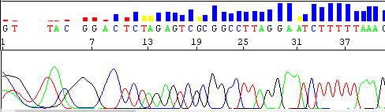
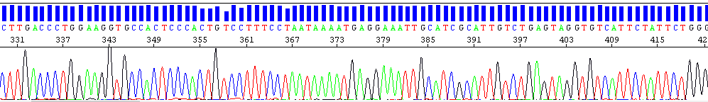
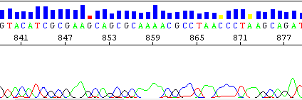
Good Sequencing Data
The least reliable data is at the beginning and end of the sequence even for well-prepared samples. This is normal and a limitation of the technology.

Slide 3
Beginning of the sequence
Peaks are rounded and not well resolved.
Note:
  The sequence of the primer is not in the data because the primer is not labelled. The nucleotides that are extended from the primer are labeled. G –black A-green T-red C – blue
  Because the data at the beginning is not reliable, make sure to design your primer ~40-50 bp upstream of your sequence of interest.

Slide 4
Middle of the sequence
Sharp, well-defined peaks with even spacing between them.
Variation in peak heights is normal.
Little to no background.

Slide 5
End of the sequence
Resolution begins to deteriorate. Peaks become broader, especially when there is more than one of the same nucleotides in a row.
Software has difficulty making accurate base calls – wide peaks may be called as multiple nucleotides instead of just one.

Slide 6
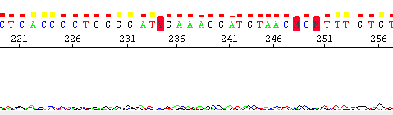
Failed Reaction
A completely failed sequencing reaction can be very difficult to diagnose as there may be multiple factors causing the problem.
Because the sequencing analysis software may still attempt to base call background noise, it’s extremely important to always look at your chromatograms and not rely solely on the text file of the sequence.
Free chromatogram viewers include Chromas and Thermo Fisher’s Sanger Quality Check App.

Slide 7
The two most common causes for sequencing failure or poor quality data are:
DNA Purity and Concentration

Slide 8
DNA Purity and Quality
Important for both quality data and to avoid damage to the DNA sequencer.

Slide 9
Common Contaminants:
Salts (EDTA, NaCl, NaOAc)
  Do NOT submit your sample in TE buffer because EDTA chelates the magnesium required by the DNA Polymerase.
  High levels of salts may also cause current instabilities which damage the capillary array.
Proteins, detergents (SDS, Triton X), organic chemicals (ethanol, chloroform, phenol), RNA
Note: Submit samples in water.

Slide 10
DNA Purity and Quality
Tips:
Avoid excessive freeze-thawing, exposure to UV light, etc. that DNA could degrade the DNA.
Some bacterial strains are better than others for template preparation.
  Some strains are known to release large amounts of endonucleases, inhibitory factors, etc. during lysis that may be difficult to remove.
Don’t overload your plasmid prep kits as many impurities can be left behind.
Do not aggressively vortex during plasmid preps to avoid nicking the DNA.

Slide 11
DNA Concentration
Both low template concentration and high template concentration cause problems.
Low Concentration
High Concentration
Results have low signal intensity.
Analysis software has difficulty in resolving the base peaks from background noise.
May cause electrophoresis issues by blocking the capillary and inhibiting the current, causing the sequencing reaction to move through the capillary abnormally.
Too much template can also deplete the dNTPs early in the sequencing reaction, leading to a premature termination of the reaction.

Slide 12
Other Considerations
Design your primer to function at the annealing temperature (60 C) that we use in the core.
  Because of the volume of samples we process we must use consensus cycling conditions for everyone.
Double check your calculations to insure you are submitting the correct amount of template and primer.
Do not use genomic DNA as a template. First amplify the region of interest using PCR. Sequence directly from the PCR product or by cloning it into a plasmid.

Slide 13
“My sample worked fine before but this time it failed.”
Your sample may have a weak signal.
A weak sample may often “work” or fail when repeated.
This is because there is bleed through of signal from adjacent capillaries.
  If your sample is in a capillary adjacent to a sample with a high signal, that sample’s signal will overpower the signal coming from your weak sample, making it appear as if it failed.
  If your weak sample was run adjacent to a blank capillary it will appear to “work” albeit with low signal.
The signal from a neighboring capillary may be so strong that the sequence from that sample shows up in your data, making you think that the core has made a mistake in processing your samples.

Slide 14
Troubleshooting Sequencing Data
Dye Blobs
Spikes
Homopolymeric Regions
Hard Stops (Truncated Sequences)
Mixed Peaks
Primer Dimers
Primer N-1

Slide 15
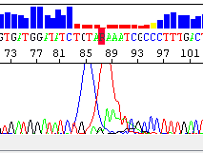
Dye Blobs
Unincorporated dye terminator molecules (ddNTPs) that were not removed during the cleanup reaction
They migrate around 60-90 bp & 90-115 bp
They are most often seen with samples of low signal strength

Slide 16
Causes of Dye Blobs
Problem occurred during the sequencing clean up protocol.
Suboptimal sequencing reaction results in poor incorporation of ddNTPs, leading to an excess of unincorporated ddNTPs that can’t be removed by the clean up protocol.
  Contaminates in the sample inhibited the sequencing reaction
  Too little starting template means less overall proportion of ddNTPs are incorporated

Slide 17
Solutions for Dye Blobs
Optimize the sequencing reaction – make sure correct amounts of template and primer are used. Make sure template and primers are pure.
Sequence from the reverse direction to obtain the sequence obscured by the dye blob.
Design a primer further upstream so that the region of interest is no longer obscured by the dye blob.

Slide 18
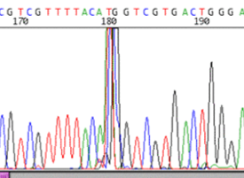
Spikes
Large peaks of all 4 colors at the same position that obscure the data.

Slide 19
Spikes
Causes of Spikes
Solution for Spikes
Small air bubbles, dust, or polymer crystals moving in the capillary through the path of the laser beam causing the laser light to refract onto the CCD camera.
Re-run sample

Slide 20
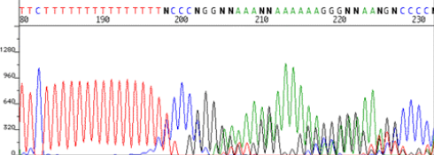
Homopolymeric Regions
A long mononucleotide stretch (most often A or T).
  Data before this encounter is good.
Data after the homopolymeric region shows double peaks and a wave-like pattern.

Slide 21
What Causes Homopolymeric Regions?
During the sequencing reaction the growing strand may dissociate and reanneal at an incorrect location in the homopolymeric region of the template. This results in the production of multiple products with varying lengths.

Slide 22
Solutions for Homopolymeric Regions
Try sequencing in the opposite direction.
It may help to design and use a primer which hybridizes close to the repeat region.
For poly A regions, use an oligo dT (12-15) primer containing C, A or G on the 3’ end as an anchor.

Slide 23
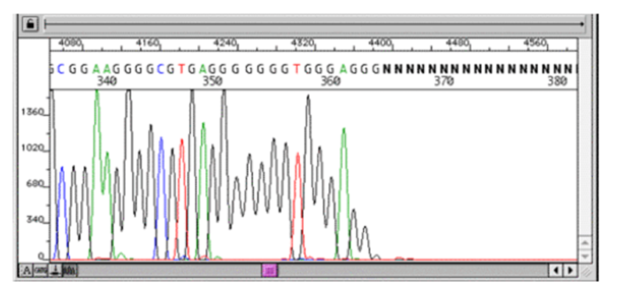
Hard Stops (Truncated Sequences)
Sequence starts out good but the signal strength suddenly stops or decreases.

Slide 24
Cause of Hard Stops
The DNA polymerase has difficulty moving through particular sequences
  Regions with a high percentage of G’s and/or C’s
  Hairpins and secondary structures

Slide 25
Solutions for Hard Stops
The addition of a denaturant such as betaine or DMSO to the sequencing reaction may help.
Try sequencing the complementary strand.
Use a primer that binds close to the hairpin.
dGTP BigDye Terminator Cycle Sequencing Kit – not offered by the GSR due to cost ($1316/100 reactions)

Slide 26
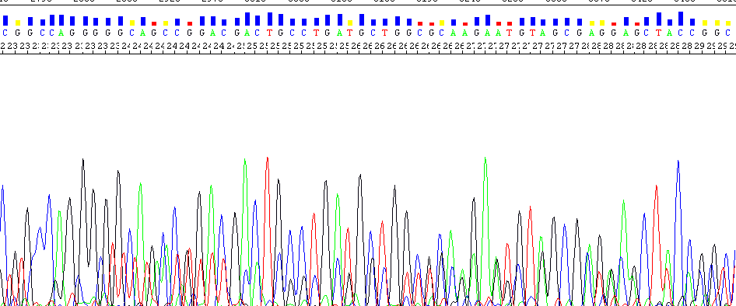
Mixed Peaks
Peaks that are superimposed on each other.

Slide 27
Causes of Mixed Peaks | Corresponding Solutions
More than one primer was present in the sequencing reaction | Purify PCR reactions before submitting for sequencing. (Because two primers are used in a PCR reaction, if excess primers are not removed before sequencing, both primers will act as sequencing primers.)
The primer is binding to multiple sites in the template | Check template for multiple priming sites. If more than one site is present, design a different primer. Make sure the primer doesn’t bind in a repeat region on the template.

Slide 28
Causes of Mixed Peaks | Corresponding Solutions
More than one template is present | PCR products: Visualize the PCR products on a gel to determine if more than one band is present. If so, gel purify the product of interest. Keep in mind, however, that products with similar sizes may not resolve well on the gel and appear as a single band. In this case you may need to optimize your PCR reaction and/or use different primers.

Slide 29
Causes of Mixed Peaks | Corresponding Solutions
Plasmid Preps: The plasmid prep contains more than one product (is mixed), for example: 1. The plasmid with the insert and the plasmid without the insert, 2. A mixture of same plasmid, but different inserts. This shows up on the chromatogram as good sequence (from the common plasmid sequence), followed by double overlapping peaks at the start of the cloning site. Note also, that during growth, spontaneous deletions or insertions may occur, giving rise to unexpected sequencing results. | Carefully pick single colonies from your plate. Perform a restriction digest and run on an agarose gel to confirm that vector and insert are present as expected.

Slide 30
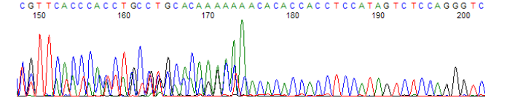
Primer Dimers
Mixed signal at the beginning, followed by clean sequence.
Solution: Redesign the primer

Slide 31
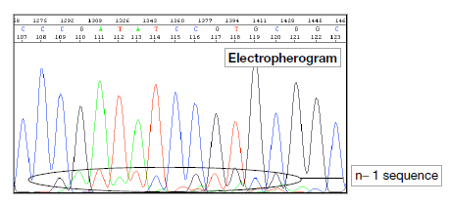
Primer N-1
Multiple peaks at all positions.
The smaller peaks are the true sequence shifted by one or two positions.

Slide 32
Primer N-1
Cause
Solution
Caused by poor quality synthesis of the primers which leads to a mixture of full length primers and primers missing one or two bases on the 5’end.
Resynthesize the primer

Slide 33
When Submitting Samples
DOs
DON’Ts
Label your tubes with consecutive #’s
  Indicate on your form the name of your sample name that corresponds with the tube #
Submit a filled out printed form with your samples AND upload your form to eRAMP
Label your submission with the eRAMP # and your NAME (first and last)
Don’t parafilm or tape your tubes together
  Makes tubes difficult to separate and ink is removed when we remove parafilm/tape
Don’t use symbols in your sample names
Don’t submit more than 16 individual tubes
  17+ put in strip tubes or plate
Don’t use flat bottom plates
  Use only PCR plates so samples don’t evaporate and can be removed from wells easily.

