Slide 1

OSUCCC Faculty Onboarding
Lab Setup, Shared Equipment, Policies
Ryan Edwards

Slide 2
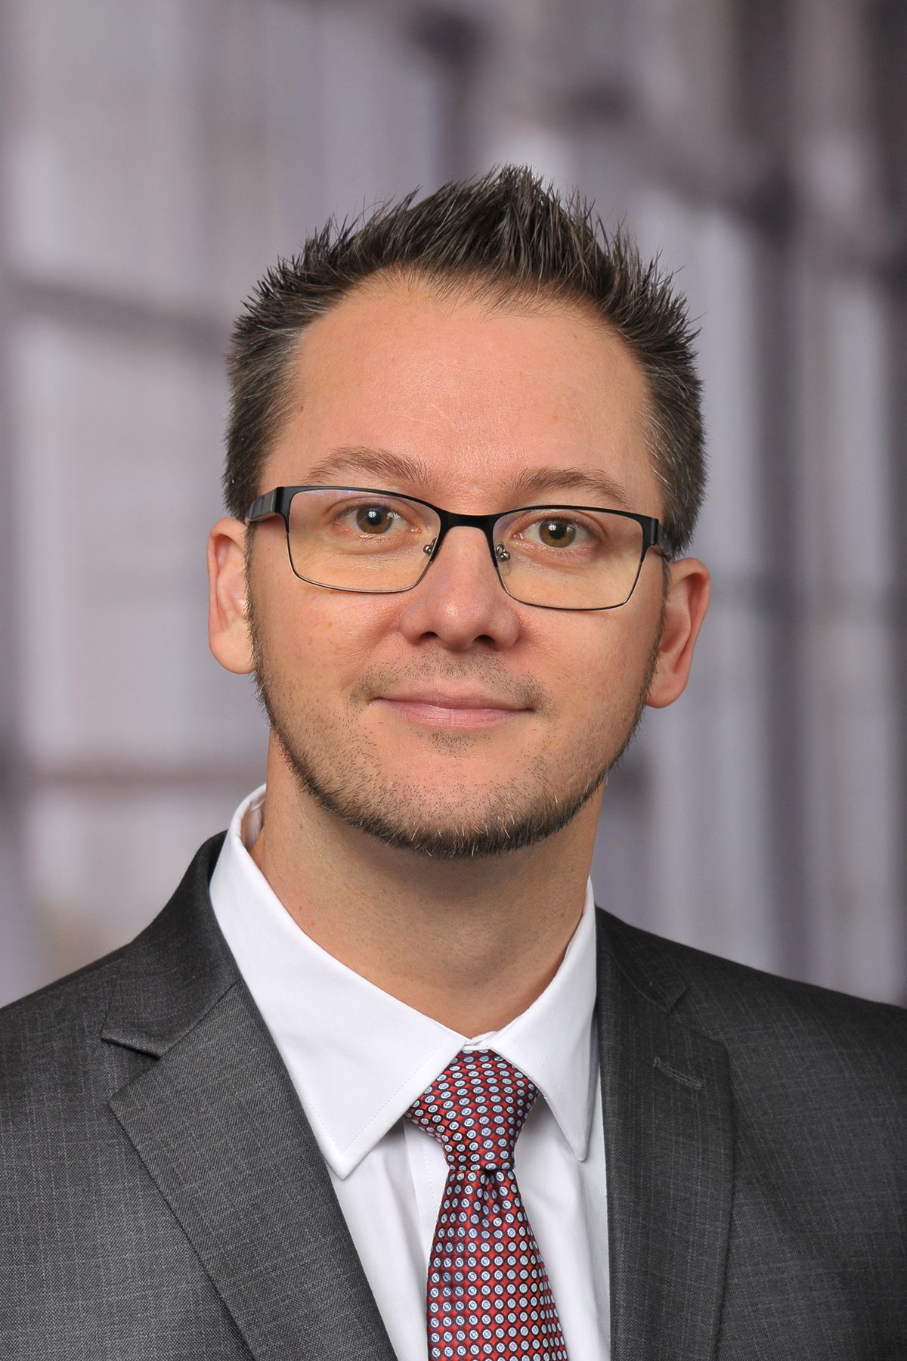
OSUCCC Space and Facilities Planning
Ryan Edwards
Program Director
Facilities and Space Planning, Research Operations, and Shared Equipment
Program and CCSG Administration, Data Management
Notes:
1

Slide 3
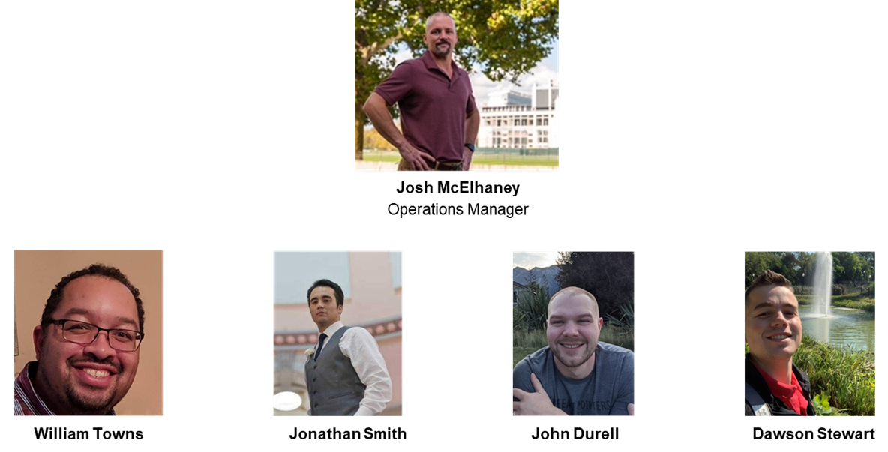

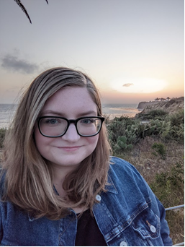
Space, Operations, & Projects (SOP)
Sarah Steck
Notes:
2

Slide 4
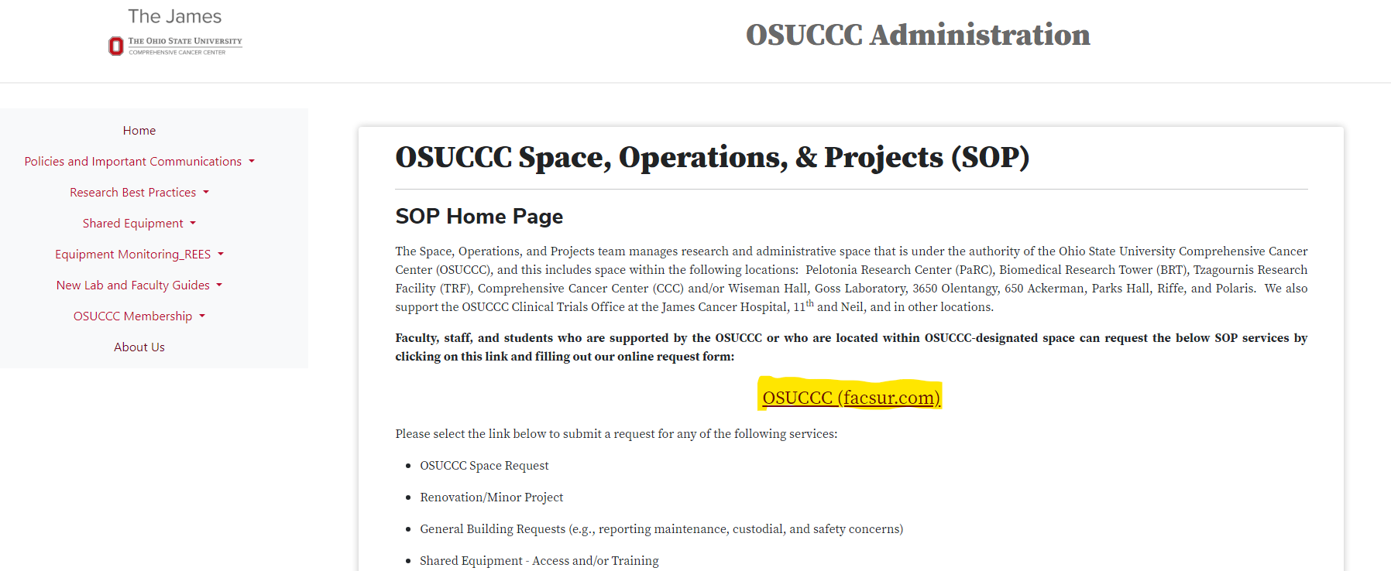
Requesting Services
https://ccc.osu.edu/sop

Slide 5
Shared Equipment
CCC-managed shared equipment is free to our members and staff.
Common examples include:
Imagers
Plate readers
Spectrophotometers
Microscopes
Irradiators
incubator shakers
High speed and ultra-centrifuges, table-top centrifuges
Cell counters
Biological safety cabinets and fume hoods
Visit our website for an updated list of shared equipment and locations. https://ccc.osu.edu/sop

Slide 6
Environmental Monitoring Requirements
All Cancer Center member labs MUST have monitoring on freezers that contain patient and research samples!
All freezers/refrigerators MUST be labeled using our equipment identification form that notes the PI’s name, names and telephone numbers of emergency contacts, and the monitoring service used by the lab.
Visit our link below for our full policy and to download our equipment identification form.
https://ccc.osu.edu/sop/policies_and_important_communications/freezer-monitoring-policy/

Slide 7
Lab Responsibilities for Tracking Equipment
Every faculty member, PI, and shared resource director whose lab is in OSUCCC space or has purchased equipment with OSUCCC funds needs to assign one or two staff to serve as Asset Coordinator (AC) for their lab or shared resource.
These coordinators will be responsible for tracking their lab’s capitalized equipment, select non-cap equipment, and IT-related assets.
WHAT COORDINATORS CAN EXPECT
Once or twice a year, ACs will be given a spreadsheet (via email) of their group’s trackable assets, and they must update this list to ensure it is accurate.
ACs must be aware of the location, condition, and status of every item on their list, and they will be asked to provide physical proof as part of this process. This will sometimes involve an in-person audit, and at other times they may need to provide pictures as requested.

Slide 8
Animal and Vivarium Questions
Dr. Valerie Bergdall is the Director of the University Laboratory Animal Resource (ULAR).
She and her team can assist you with questions about transferring animals, using vivarium space, and setting up animal protocols.
ULAR website: https://ular.osu.edu
Email: bergdall.1@osu.edu
For assistance with IACUC protocols: Angela Phillips: Phillips.270@osu.edu
For assistance with animal transfer: animaltransport@osu.edu

Slide 9
We are excited to welcome you to
The Ohio State University Comprehensive Cancer Center
Important Contacts
Ryan.Edwards@osumc.edu
Josh.McElhaney@osumc.edu

